Slide 1


Slide 2
Workshop: Aims & Objectives
To Encourage and Inspire Attendees
Moving Forward: Press l Push l Persevere
As
1. Individuals
2. Families
3. Churches

Slide 3
Welcome & Introduction
Rev Errol Vassell
Assemblies of the First Born

Slide 4
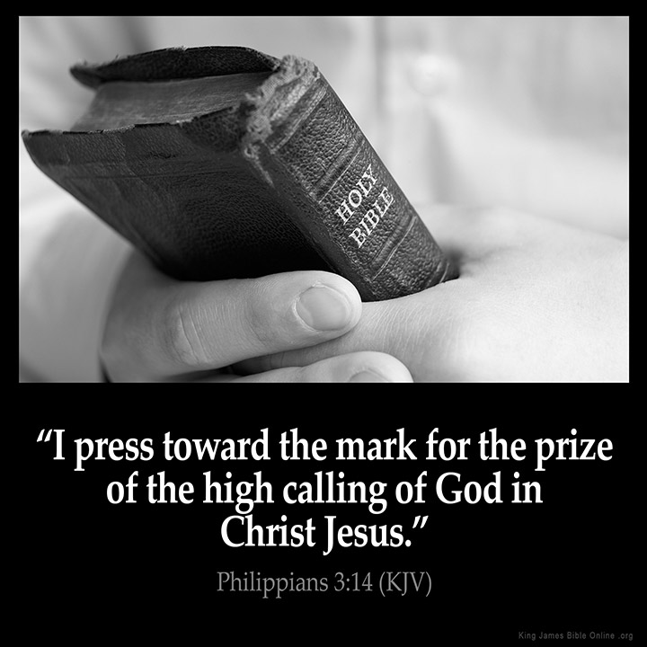

Slide 5
1 Samuel 30:18-19
18 And David recovered all that the Amalekites had carried away: and David rescued his two wives.
19 And there was nothing lacking to them, neither small nor great, neither sons nor daughters, neither spoil, nor any thing that they had taken to them: David recovered all.

Slide 6
INDIVIDUALS

Slide 7
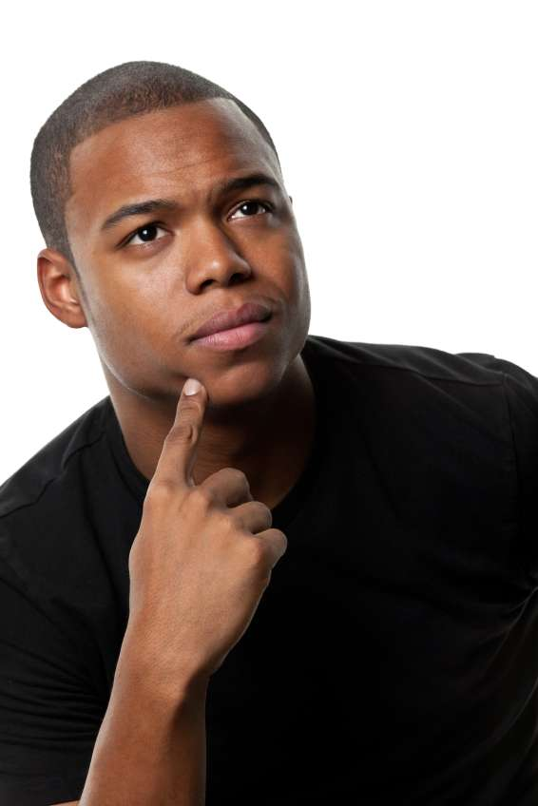


Slide 8
Proverbs 23:7
7 For as he thinketh in his heart, so is he.
Proverbs 4:23
23 Keep thy heart with all diligence; for out of it are the issues of life.
Romans 12:2
2 And be not conformed to this world: but be ye transformed by the renewing of your mind, that ye may prove what is that good, and acceptable, and perfect, will of God.

Slide 9
FAMILIES

Slide 10
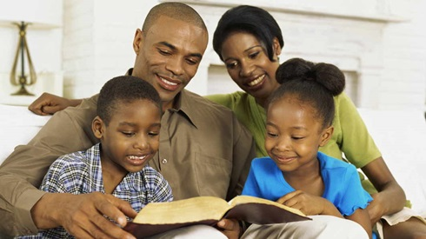

Slide 11
The Concept of Family is very important right from the beginning of the Bible
Genesis 1:28
Genesis 6:18
Deuteronomy 4:8-9

Slide 12
CHURCHES

Slide 13


Slide 14
2 Timothy 2:1-3
1 Thou therefore, my son, be strong in the grace that is in Christ Jesus.
2 And the things that thou hast heard of me among many witnesses, the same commit thou to faithful men, who shall be able to teach others also.
3 Thou therefore endure hardness, as a good soldier of Jesus Christ.

Slide 15
Ephesians 4:11-15
11 And he gave some, apostles; and some, prophets; and some, evangelists; and some, pastors and teachers;
12 For the perfecting of the saints, for the work of the ministry, for the edifying of the body of Christ:
13 Till we all come in the unity of the faith, and of the knowledge of the Son of God, unto a perfect man, unto the measure of the stature of the fulness of Christ:
14 That we henceforth be no more children, tossed to and fro, and carried about with every wind of doctrine, by the sleight of men, and cunning craftiness, whereby they lie in wait to deceive;
15 But speaking the truth in love, may grow up into him in all things, which is the head, even Christ:

Slide 16
Where Are You?

Slide 17


Slide 18
Genesis 3:8-10
8 And they heard the voice of the Lord God walking in the garden in the cool of the day: and Adam and his wife hid themselves from the presence of the Lord God amongst the trees of the garden.
9 And the Lord God called unto Adam, and said unto him, Where art thou?
10 And he said, I heard thy voice in the garden, and I was afraid, because I was naked; and I hid myself.

Slide 19
What Steps Do You Need To Take?

Slide 20


Slide 21
Psalm 37:23-25
23 The steps of a good man are ordered by the Lord: and he delighteth in his way.
24 Though he fall, he shall not be utterly cast down: for the Lord upholdeth him with his hand.
25 I have been young, and now am old; yet have I not seen the righteous forsaken, nor his seed begging bread.

Slide 22
What Are The Barriers You Face?

Slide 23


Slide 24
Zechariah 4:6-9
6 Then he answered and spake unto me, saying, This is the word of the Lord unto Zerubbabel, saying, Not by might, nor by power, but by my spirit, saith the Lord of hosts.
7 Who art thou, O great mountain? before Zerubbabel thou shalt become a plain: and he shall bring forth the headstone thereof with shoutings, crying, Grace, grace unto it.
8 Moreover the word of the Lord came unto me, saying,
9 The hands of Zerubbabel have laid the foundation of this house; his hands shall also finish it; and thou shalt know that the Lord of hosts hath sent me unto you.

Slide 25
How Can You Overcome The Barriers?

Slide 26


Slide 27


Slide 28
Joshua 1:8-11
8 This book of the law shall not depart out of thy mouth; but thou shalt meditate therein day and night, that thou mayest observe to do according to all that is written therein: for then thou shalt make thy way prosperous, and then thou shalt have good success.
9 Have not I commanded thee? Be strong and of a good courage; be not afraid, neither be thou dismayed: for the Lord thy God is with thee whithersoever thou goest.
10 Then Joshua commanded the officers of the people, saying,
11 Pass through the host, and command the people, saying, Prepare you victuals; for within three days ye shall pass over this Jordan, to go in to possess the land, which the Lord your God giveth you to possess it.

Slide 29
The Commitment

Slide 30
Philippians 1:21 (AMP)
21 For to me, to live is Christ [He is my source of joy, my reason to live] and to die is gain [for I will be with Him in eternity].

Slide 31
Jesus has made it plain, the cost of discipleship: “If anyone would come after Me, let him deny himself and take up his cross daily and follow Me. For whoever would save his life will lose it, but whoever loses his life for My sake will save it” (Luke 9:23-24). In essence, the true cost of commitment to Christ is one’s total self-denial, cross-bearing, and the continual following of Him. These imperatives picture for us sacrifice, selflessness, and service.

Slide 32
Let Us Pray

