Slide 1
Discipleship Training
“The strength and influence of the church is wholly dependent upon its commitment to true discipleship.”
- George Barna
Growing True Disciples

Slide 2
Aims and Objectives
To fulfil the Great Commission:
“Therefore go and make disciples of all nations, baptising them in the name of the Father and of the Son and of the Holy Spirit, and teaching them to obey everything I have commanded you.”
Matthew 28:19-20

Slide 3
Aims and Objectives
By the end of this training session
participants will be able to:
* Explain what is a Christian
* Explain what is a Disciple
* Explain what is Christian Discipleship
* List barriers to Christian Discipleship
* List the thinking and mindset required to achieve Christian Discipleship

Slide 4
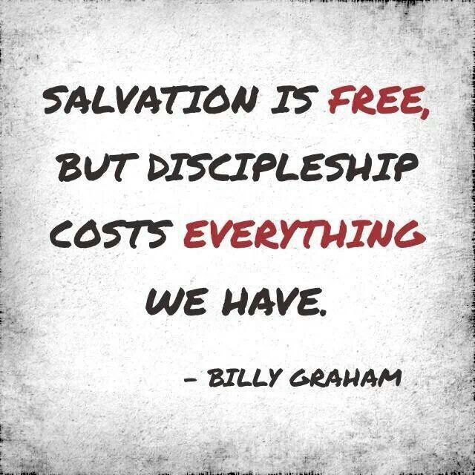
What is Discipleship?

Slide 5
What would you tell a person who asked you what do they have to do to be saved?

Slide 6
The Gift of Salvation
  God Loves Us
      John 3:16
  Man Is Sinful And Separated From God
      Romans 3:23
      Romans 6:23
      Isaiah 59:2
  Jesus Christ Is God’s ONLY Provision For Man’s Sin
      John 14:6
      Romans 5:8
  We Must Individually Receive Jesus As Saviour And Lord
      John 1:12
      Romans 10:9
      Ephesians 2:8

Slide 7
The Gift of Salvation
Roman Road
  ALL Are Sinners
      Romans 3:23
  Penalty For Sin Is Death
      Romans 6:23
  Christ Paid Our Penalty
      Romans 5:8
  Confess, Believe, Pray, & Receive
      Romans 10:9

Slide 8
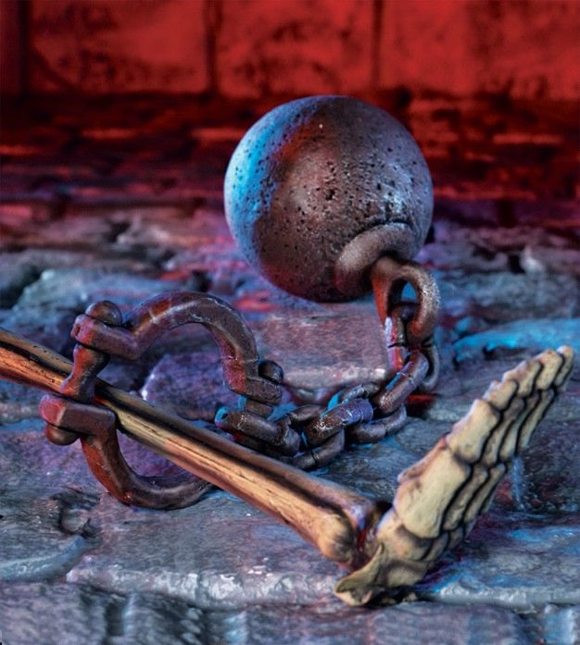
Romans 3:23
For all have sinned, and
come short of the glory of
God;

Slide 9
Romans 6:23
For the wages of sin is
death; but the gift of
God is eternal life
through Jesus Christ our
Lord.

Slide 10
Romans 5:8
But God commendeth his
love toward us, in that,
while we were yet
sinners, Christ died for
us.

Slide 11
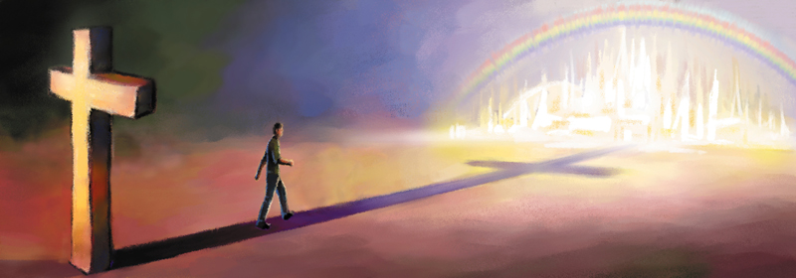
Romans 10:9
That if thou shalt
confess with thy mouth
the Lord Jesus, and shalt
believe in thine heart
that God hath raised him
from the dead, thou shalt
be saved.

Slide 12
What is Discipleship?

Slide 13
Elements of Conversion
(Decision for Christ)
What is Conversion?
belief in Jesus and his victory at Calvary – His Death, Resurrection and Ascension
repentance
trust / assurance of salvation
commitment and devotion
giving a verbal witness to Him
public baptism
incorporation into a Christian community

Slide 14
What is Discipleship?
It is fulfilling the Great Commission:
“Therefore go and make disciples of all nations, baptising them in the name of the Father and of the Son and of the Holy Spirit, and teaching them to obey everything I have commanded you.”
Matthew 28:19-20

Slide 15
What is Christian Discipleship?
Christian = “belonging to Christ” was a term never used
by Jesus, the disciples were first called Christians in
Antioch (Acts 11:26)
Disciple (Greek Word is “machetes” = student,
or learner. A committed Follower. Someone who accepts
and assists spreading the doctrines of another (e.g.
Pharisees were disciples of Moses – John 9:28)
Christian Disciple = A person who accepts and
assists in the spreading of the good news of
Jesus Christ.

Slide 16
What is Christian Discipleship?
Christian Discipleship is the process by
which disciples grow in the Lord Jesus Christ
and are equipped by the Holy Spirit to
overcome the pressures and trials of this
present life and become more Christ-like.
(John 14:12-18)
(John 16:33)
(2 Corinthians 3:18)
(Romans 9:29)

Slide 17
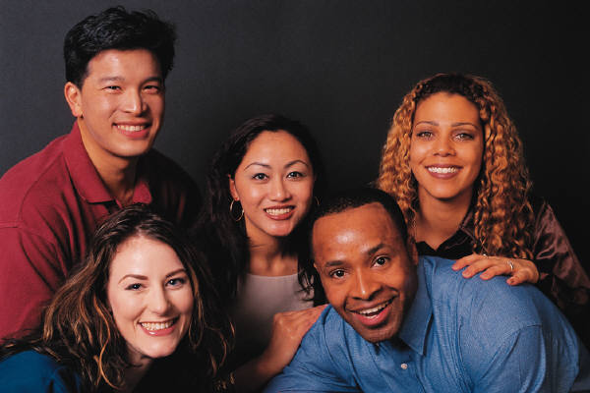
Defining: What is Discipleship?
“Christian discipleship is a process that takes place within accountable relationships over a period of time for the purpose of bringing believers to spiritual maturity in Christ.”

Slide 18
What is Discipleship?
“Christian discipleship is a process that takes place within accountable relationships over a period of time for the purpose of bringing believers to spiritual maturity in Christ.”

Slide 19
Discipleship Is…
A process:
Disciple-making is a shift from programme- driven ministry to people-driven ministry … move from concern about quantity (people, programmes, size of church, income) to concern about quality (commitment, wisdom, relationships, values, lifestyle).

Slide 20
What is Discipleship?
“Christian discipleship is a process that takes place within accountable relationships over a period of time for the purpose of bringing believers to spiritual maturity in Christ.”

Slide 21
Why Discipleship?
“There leaving the principles of the doctrine of Christ, let us go unto perfection (spiritual maturity).” (Hebrews 6:1a)
“But, beloved, we are persuaded better things
of you, and things that accompany salvation, though we thou speak.” (Hebrews 6:9)

Slide 22
Why Discipleship?
“And the things you have heard me say in the presence of many witnesses entrust to reliable men who will also be qualified to teach others.”
2 Timothy 2:2

Slide 23
Why Focus On Discipleship?
If churches continue to do what we’ve always done, we’re going to get what we’ve always gotten.
Current reality…

Slide 24
Discipleship?
We need to ask:
What does a spiritually mature believer look like? How do I recognise a disciple of Christ?
What is our church doing to ensure that we produce spiritually mature believers? Do we have an intentional disciple-making plan?
Do I understand how our plan works?

Slide 25
Why Discipleship?
“Disciples don’t just happen. They’re developed through intentional planning and the effort of a community of believers. We can make disciples in our church. But it won’t just happen. You need to decide what you’re going to do and how to do it.”

Slide 26
Characteristics of A Spiritually Mature Christian Disciple?
Saved - accepted Jesus Christ as their Lord and
Saviour.
Studies and mediates on the Word of God.
A Lifestyle based on prayer, fasting and worship.
Produces the Fruit of the Spirit.
Great peace in the midsts of the storms of life.
Spreading the Good News of the Gospel of Jesus Christ.

Slide 27
Discipleship Training on Sunday Nights has begun…
Building slowly
Involving regional churches
Using both Spring and Summer evenings
Focus is on both the Word of God and Prayer and the importance of building relationships.

Slide 28
Why Discipleship?
We need to ask:
What does a spiritually mature believer look like? How do I recognise a disciple of Christ?
What is our church doing to ensure that we produce spiritually mature believers? Are we developing an intentional disciple-making plan?

Slide 29
Discipleship Training gently facilitates a right hand column thinking & mindset
CONVERT DISCIPLE
DECISION. SPIRITUAL FORMATION
PROGRAM. PROCESS
INFORMATION. TRANSFORMATION
FAST. SLOW

Slide 30
Discipleship Training gently facilitates a right hand column thinking & mindset
SHORT LONG & SUSTAINED
EASY DIFFICULT
QUICK ENDING BEGINNING
EVENT ON-GOING

Slide 31
Discipleship Training gently facilitates a right hand column thinking & mindset
INSTANT. ___ SEVERAL YEARS
DIET. LIFESTYLE
HABITS (BAD) HABITS (GOOD)
TRYING. TRAINING
ADHOC DISCIPLINED

Slide 32
Discipleship Training gently facilitates a right hand column thinking & mindset
IRRESPONSIBLE ACCOUNTABLE
CORPORATE PERSONAL
DESTINATION JOURNEY
SPECTATOR PARTICIPITANT
IMMATURE MATURE

Slide 33
What are the barriers to Discipleship Success?

Slide 34
Barriers to Discipleship Success
Time availability
Interest and commitment
Programme mentality
Logistical issues
Preparation time
Scripture memorisation
spiritual maturity

Slide 35
How Any Disciple-Making Works!
Spiritual success relies on relationships,
listening, encouraging, accountability,
and a time commitment from everyone what is
involved. It is hard, slow people work! But it is
SO WORTH IT!

Slide 36

Any Questions
Training Session Evaluation

